Slide 1

The influence of parental attitude on children's behavior
University of Alicante
Eirini Kouki
PhD Candidate at the university of Alicante
June 2025
eirinigkouki@gmail.com

Slide 2
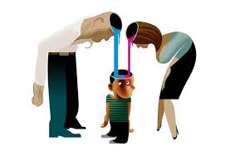
The influence of parental attitude on children's behavior
Τhe intricate dynamics of the family unit can:
promote an encouraging environment for positive behavioral, development,
Or conversely
create the conditions for delinquent tendencies

Slide 3
Τhe POSITIVE influence of parents on their children's behavior 1/4
Research consistent sHOWS that authoritative parenting characterized
by a balanced approach of warmTH and control,
is significantly associated with A reducTION IN JUVENILE DELINQUENCY.
Xiong, Li, and Xia, (2020), in their PROSPECTIVE study of Chinese ADOLESCENTS EMPHASIZED that children raised
by authoritarian parents exhibited lower levels of delinquent behavior and were less likely to be victims of delinquency.

Slide 4

Τhe POSITIVE influence of parents on their children's behavior 2/4
This positive parenting style promotes:
sets clear expectations
open communication,
and imposes consistent discipline
all of which collectively contribute to better self-regulation and moral
development IN CHILDREN,

Slide 5

Τhe POSITIVE influence of parents on their children's behavior 3/4
IN ADDITION,
High levels of parental
involvement in a child's education
and daily activities
are essential FOR CULTIVATING a sense
of security and belonging,
which are VITAL for positive behavior

Slide 6

Τhe POSITIVE influence of parents on their children's behavior 4/4
FURTHERMORE, families with
economic PROSPERITY,
mental health
and communication strategies AMONG family members,
Have
a positive effect on their children's behavior,
STRENGTHEN family cohesion
and reduce any delinquent tendencies

Slide 7
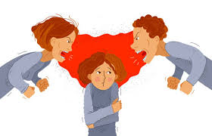
Τhe negative parental influence on their children's behavior 1/3
Permissive and neglectful parenting characterized by low expectations and lack of supervision,
has been linked to higher rates
of behavioral problems and delinquency.
More,
Walters (2021) further clarifies that
inadequate parental control can often
increase children's cognitive impulsivity,
thus reinforcing their tendency toward delinquent behavior.

Slide 8

Τhe negative parental influence on their children's behavior 2/3
Additionally
parental behaviors such as
inconsistent discipline,
lack of emotional support
and exposure to domestic violence
are all harmful and strongly increase
the risk of delinquency.

Slide 9

Τhe negative parental influence on their children's behavior 3/3
Finally
financial difficulties
increased levels of stress
And mental health problems
lead families
to fail to provide and support adequate parental care and supervision, often unintentionally contributing to an increase in behavioral problems and delinquency

Slide 10

Conclusion of research
In conclusion,
the research highlights that the various aspects of parental influence and child behavior interact and are interdependent,
beneficial parenting, characterized by
authoritative practices, active involvement
and consistent supervision, acts as a powerful
deterrent against juvenile delinquency,
conversely, neglect and inconsistent parenting, combined with socio-economic and psychological challenges, significantly increase the risk of delinquent behavior.

Slide 11

the research proposal
Addressing these issues through targeted intervention
programs
can reduce risks by promoting
healthier developmental outcomes for children.
Counselling interventions, ranging from family therapy to group sessions and cognitive behavioral approaches,
play a vitally important role in reducing delinquent behavior in schools
and promoting positive behavioral
development and long-term social benefits

Slide 12

sources
Aw, S., Widiarti, P. W., Setiawan, B., Mustaffa, N., Ali, M. N. S., & Hastasari, C. (2020). Parenting and sharenting communication for preventing juvenile delinquency. Inform, 50(2), 177-186.
Barger, M. M., Kim, E. M., Kuncel, N. R., & Pomerantz, E. M. (2019). The relation between parents’ involvement in children’s schooling and children’s adjustment: A meta-analysis. Psychological bulletin, 145(9), 855.
Flanagan, I. M., Auty, K. M., & Farrington, D. P. (2019). Parental supervision and later offending: A systematic review of longitudinal studies. Aggression and violent behaviour, 47, 215-229.
Giotsa, A. (2015). social psychology and social pedagogy: their interdisciplinarity in group counselling for parents.International Journal of Social Pedagogy, 4(1), 219-226.
Hosokawa, R., & Katsura, T. (2019). Role of parenting style in children’s behavioural problems through the transition from preschool to elementary school according to gender in Japan. International journal of environmental research and public health, 16(1), 21.
Jacobsen, W. C. (2019). The intergenerational stability of punishment: Paternal incarceration and suspension or expulsion in elementary school. Journal of Research in Crime and Delinquency, 56(5), 651-693.
Kethineni, S., Frazier‐Kouassi, S., Shigemoto, Y., Jennings, W., Cardwell, S. M., Piquero, A. R., ... & Sundaravadivelu, D. (2021). PROTOCOL: Effectiveness of parent‐engagement programs to reduce truancy and juvenile delinquency: A systematic review. Campbell systematic reviews, 17(3), e1189.
Mwangangi, R. K. (2019). The role of family in dealing with juvenile delinquency. Open Journal of Social Sciences, 7(3), 52-63.
Thanopoulou, M. A., Riga, P., & Tsaroucha, G. (2014). School delinquency in primary education. The role of school and family.
Walters, G. D. (2021). Parental control as a stimulus for youth control: Mediating the parental knowledge–child delinquency relationship with cognitive impulsivity. Crime & Delinquency, 67(5), 717-736.
Weisman, C. B. (2020). Functional Family Therapy: analysis of effect and implementation (Doctoral dissertation, University of Birmingham).
Xiong, R., Li, S. D., & Xia, Y. (2020). A longitudinal study of authoritative parenting, juvenile delinquency and crime victimisation among Chinese adolescents. International journal of environmental research and public health, 17(4), 1405.

Slide 13
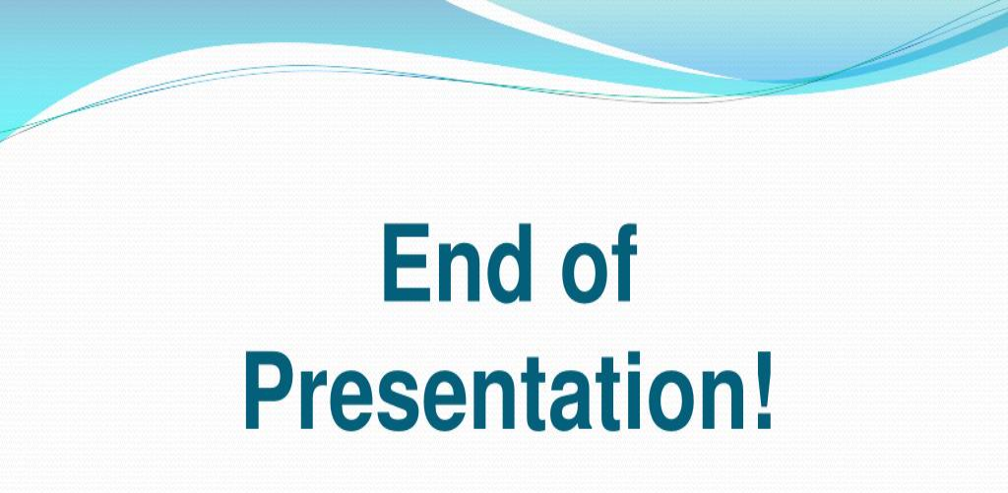

Eirini Kouki
PhD Candidate at the university of Alicante
June 2025
eirinigkouki@gmail.com

